Slide 1
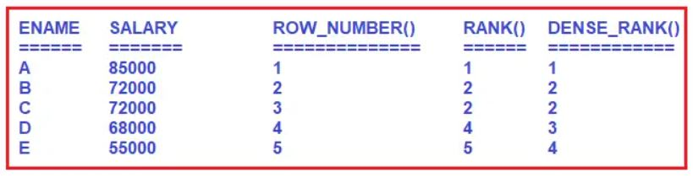
Analytical Functions in Oracle
Oracle supports the following three types of analytical functions
Row_Number()
Rank()
Dense_Rank()
These analytical functions are automatically generated ranking numbers for each row-wise (or) group of rows-wise. These are also called “Ranking Functions” in Oracle.
As you can see in the above image, the ROW_NUMBER() function will assign a different rank number to the same value whereas the RANK(), DENSE_RANK() function will assign the same rank number to the same value. But Rank() function will skip the next rank number in the order whereas DENSE_RANK() function will not skip the next rank number in the orde

Slide 2
Analytical Functions in Oracle
Syntax: ANALYTICAL FUNCTION NAME() OVER( [ PARTITION BY <COLUMN NAME> ] ORDER BY <COLUMN NAME> [ASC / DESC ])
OVER Clause in Oracle:
The OVER clause in Oracle is used with the PARTITION BY clause to break the data into partitions.
<FUNCTION> OVER( [ PARTITION BY <COLUMN NAME> ] ORDER BY <COLUMN NAME> [ASC / DESC ])

Slide 3
Analytical Functions in Oracle
Example:
Our business requirement is to generate a report that should display the total number of employees in each department, we also need to display the Total Salary, Average Salary, Minimum Salary, and Maximum Salary of each department
SELECT Dept_name,
COUNT(*) AS TotalEmployees,
SUM(CTC) AS TotalSalary,
AVG(CTC) AS AverageSalary,
MIN(CTC) AS MinSalary,
MAX(CTC) AS MaxSalary
FROM department d inner join emps e
on d.dept_id = e.dept_id
GROUP BY Dept_name;

Slide 4
Analytical Functions in Oracle
Now our business requirement changes. Now we also want to show the non-aggregated values (emp_Name and CTC) in the report along with the aggregated values as shown in the below image.
SELECT Dept_name,emp_name,ctc,
COUNT(emp_id) AS TotalEmployees,
SUM(CTC) AS TotalSalary,
AVG(CTC) AS AverageSalary,
MIN(CTC) AS MinSalary,
MAX(CTC) AS MaxSalary
FROM department d inner join emps e
on d.dept_id = e.dept_id
GROUP BY Dept_name;
not a GROUP BY expression
00979. 00000 - "not a GROUP BY expression"
*Cause:
*Action:
Error at Line: 115 Column: 19

Slide 5
Analytical Functions in Oracle
In order to get the desired output is by using the OVER clause combined with the PARTITION BY clause
SELECT DEPT_NAME,EMP_NAME,CTC,
COUNT(emp_name) OVER(PARTITION BY dept_name) AS TotalEmployees,
SUM(CTC) OVER(PARTITION BY dept_name) AS TotalSalary,
AVG(CTC) OVER(PARTITION BY dept_name) AS AverageSalary,
MIN(CTC) OVER(PARTITION BY dept_name) AS MinSalary,
MAX(CTC) OVER(PARTITION BY dept_name) AS MaxSalary
FROM DEPARTMENT D INNER JOIN EMPS E
ON D.DEPT_ID = E.DEPT_ID

Slide 6
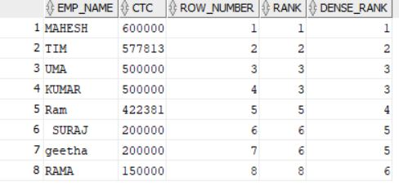
Analytical Functions Without Partition by Clause in Oracle
SELECT EMP_Name, CTC,
ROW_NUMBER() OVER(ORDER BY CTC DESC) ROW_NUMBER,
RANK() OVER(ORDER BY CTC DESC) RANK,
DENSE_RANK() OVER(ORDER BY CTC DESC) DENSE_RANK
FROM Emps;

Slide 7
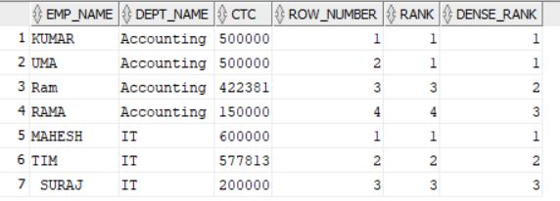
Ranking Functions with Partition by Clause.
SELECT EMP_NAME, DEPT_NAME,CTC,
ROW_NUMBER() OVER(PARTITION BY DEPT_NAME ORDER BY CTC DESC) ROW_NUMBER,
RANK() OVER(PARTITION BY DEPT_NAME ORDER BY CTC DESC) RANK,
DENSE_RANK() OVER(PARTITION BY DEPT_NAME ORDER BY CTC DESC) DENSE_RANK
FROM DEPARTMENT D INNER JOIN EMPS E
ON D.DEPT_ID = E.DEPT_ID

Slide 8
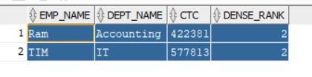
Analytical Function
Example:
WAQ to display 2nd highest salary employee details from Employees table in each department wise by using DENSE_RANK()
select * from
(SELECT EMP_NAME, DEPT_NAME,CTC,
DENSE_RANK() OVER(PARTITION BY DEPT_NAME ORDER BY CTC DESC) DENSE_RANK
FROM department d inner join emps e
on d.dept_id = e.dept_id)ranking
where DENSE_RANK = 2

Slide 9
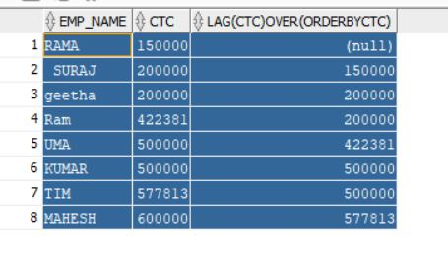
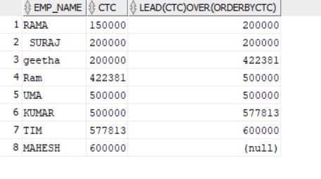
Lead and Lag
select emp_name,ctc,lag(ctc) over(order by ctc)
from emps
select emp_name,ctc,lead(ctc) over(order by ctc)
from emps

